Slide 1

Project Title: BiDAF for SQUAD 2.0 Team Members: YASASVI THATI SRI VISHNUPRIYA SANGARAJU

Slide 2
Squad dataset
Stanford Question Answering Dataset (SQuAD) is a reading comprehension dataset, consisting of questions posed by crowdworkers on a set of Wikipedia articles, where the answer to every question is a segment of text, or span, from the corresponding reading passage, or the question might be unanswerable.
SQuAD 1.1, the previous version of the SQuAD dataset, contains 100,000+ question-answer pairs on 500+ articles.
SQuAD2.0 combines the 100,000 questions in SQuAD1.1 with over 50,000 unanswerable questions written adversarial by crowdworkers to look similar to answerable ones.

Slide 3
PROJECT OBJECTIVE
The main goal of the project is to enhance the ability to answer questions using the SQuAD 2.0 dataset, with a specific focus on improving the BiDAF model through the substitution of Bi-LSTM with GRU.
Along with measuring the robustness of BiDAF to adversarial examples and comparing the performance of BiDAF with fine-tuned BERT and other pretrained models in terms of data requirements vs performance and training cost vs performance.

Slide 4
STATEMENT OF VALUE
Complex Challenge: The project addresses the difficult SQuAD 2.0 dataset, which contains questions with no explicit solutions, making it a valuable research project.
Model Improvement: The project's goal is to improve the performance of the BiDAF model by integrating a Gated Recurrent Unit (GRU), which might lead to greater question-answering capabilities.
Practical Applications: Successful question-answering model modifications have practical uses in sectors such as retrieving data and virtual assistants.
Contributing to Knowledge: The project contributes to the NLP and deep learning communities by sharing thoughts and discoveries that may be utilized to progress the field by other researchers.

Slide 5
STATE OF ART
The use of deep learning, transfer learning, large-scale datasets, and creative architectural designs has resulted in the present state of the art in question-answering models.
These advances have resulted in significant gains in models' capacity to interpret text and offer accurate answers across a wide number of areas.
The discipline is still evolving, with an emphasis on increasing both accuracy and model interpretability.

Slide 6
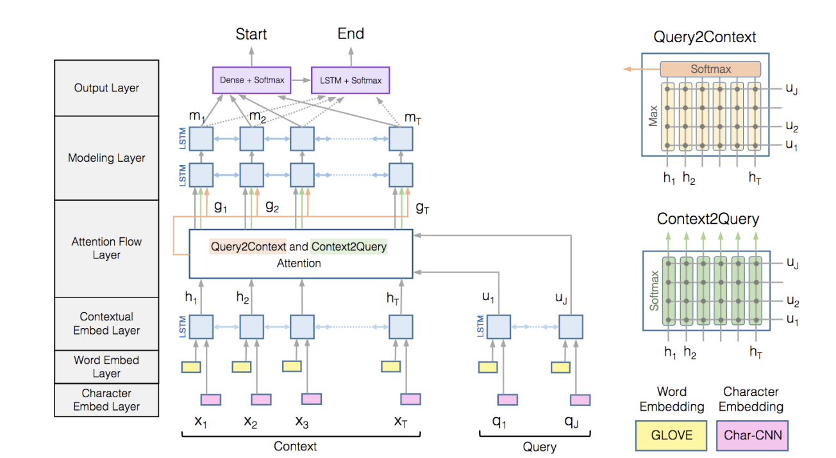
BiDAF Baseline Model

Slide 7
APPROACH
SQuAD 2.0 Dataset
Bi-Directional Attention Flow (BiDAF) model (Bi-LSTM & GRU)
Hyperparameter Tuning
Measuring the robustness of BiDAF to adversarial examples
Comparing the performance of BiDAF with fine-tuned BERT
Evaluation
Analysis

Slide 8
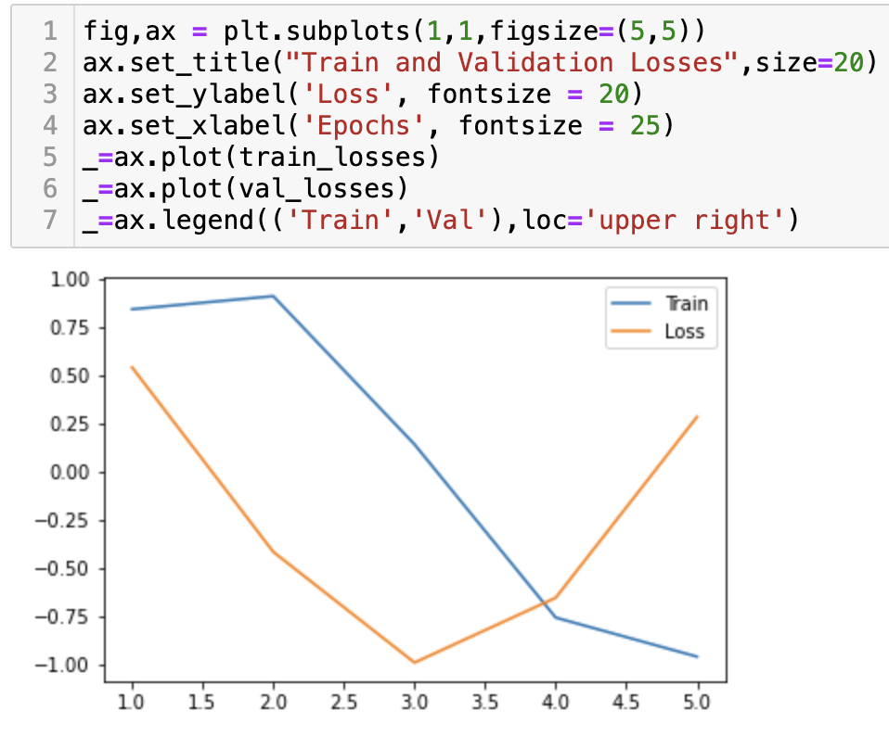
OUTPUT

Slide 9
deliverables
Python File (ipynb file)
GitHub Link
Documentation

Slide 10
Evaluation methodology
Exact Match (EM): Exact Match is a strict evaluation metric that only gives two scores (0 or 1).
F1 Score: The F1 score is a combined metric that considers both precision and recall. It calculates the harmonic mean of precision and recall for the response words.

Slide 11
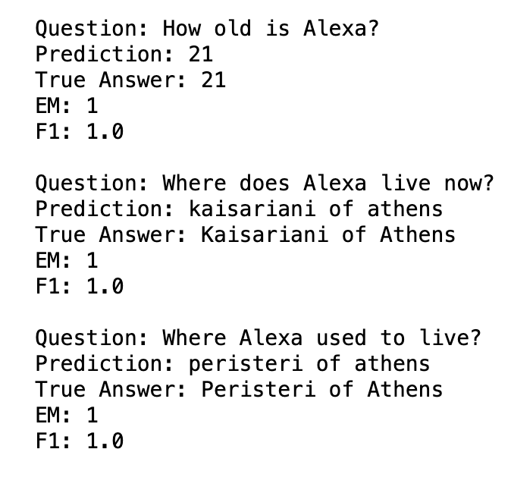
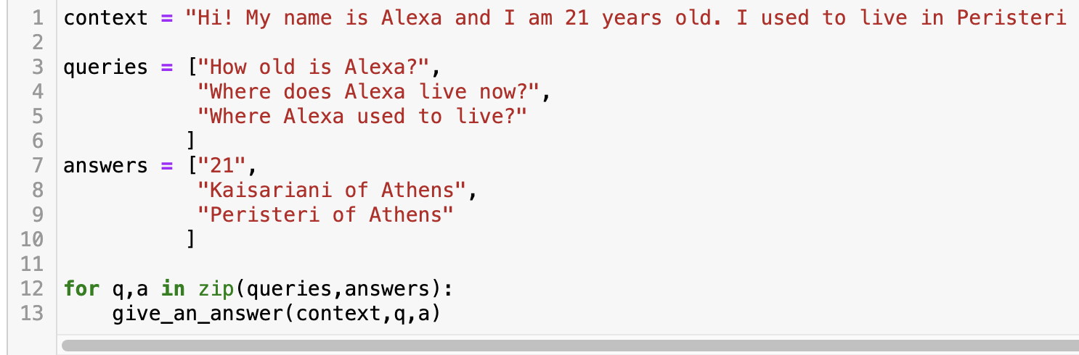
Continue…

Slide 12
citations
https://rajpurkar.github.io/SQuAD-explorer/
https://web.stanford.edu/class/archive/cs/cs224n/cs224n.1224/reports/default_116994704.pdf
https://web.stanford.edu/class/archive/cs/cs224n/cs224n.1214/reports/final_reports/report243.pdf
https://web.stanford.edu/class/archive/cs/cs224n/cs224n.1214/project/default-final-project-handout-squad-track.pdf
https://web.stanford.edu/class/archive/cs/cs224n/cs224n.1214/project/default-final-project-handout-robustqa-track.pdf

